Slide 1
Warp Speed Testing at an Enterprise Level Scott Mills
Andrei Juc

Slide 2
Agenda

Slide 3

What are we covering in this session?
About us
About Rogue Wave
The problem
The challenge
The solution
AWS Tips
Jenkins plugins
What’s next
Closing thoughts
Notes:
Honeywell

Slide 4

What will you take away from this session?
Configuring Jenkins to work with AWS
Setting up Jenkins jobs to use AWS resources
Using Docker with AWS
Useful Jenkins Plugins
Using on-demand resources
AWS Tips
Potential pitfalls & limitations
Notes:
Honeywell

Slide 5
About us

Slide 6




Ottawa, ON
Las Vegas, NV
Notes:
Honeywell

Slide 7
Scott Mills
Technical background
Almost 20 years designing, developing, maintain and supporting automation systems
Application performance testing
Application security testing (OWASP Top 10)
Automated web testing
Build & test automation framework development and evolution utilizing Python, Jenkins, Docker and Amazon Web Services
Notes:
Honeywell

Slide 8


Scott Mills
While not automating…
Notes:
Honeywell

Slide 9
Andrei Juc
Technical background
Automation framework developer
VM to Docker migration
Amazon Web Services migration
Troubleshooting enthusiast
Innovator
Notes:
Honeywell

Slide 10
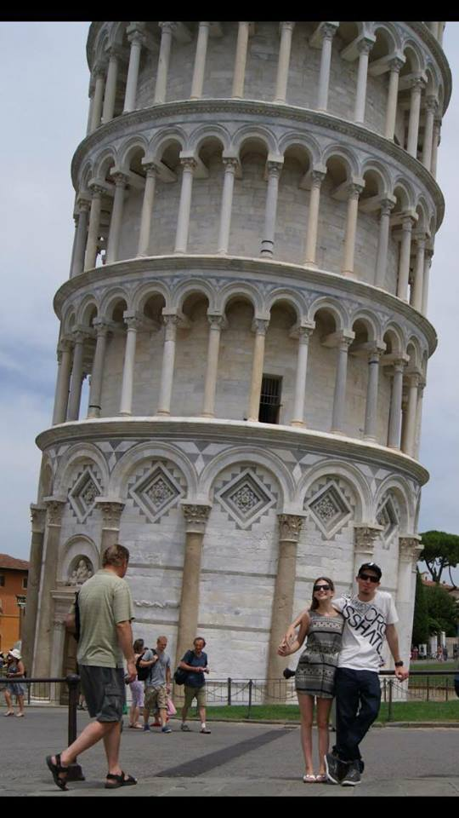
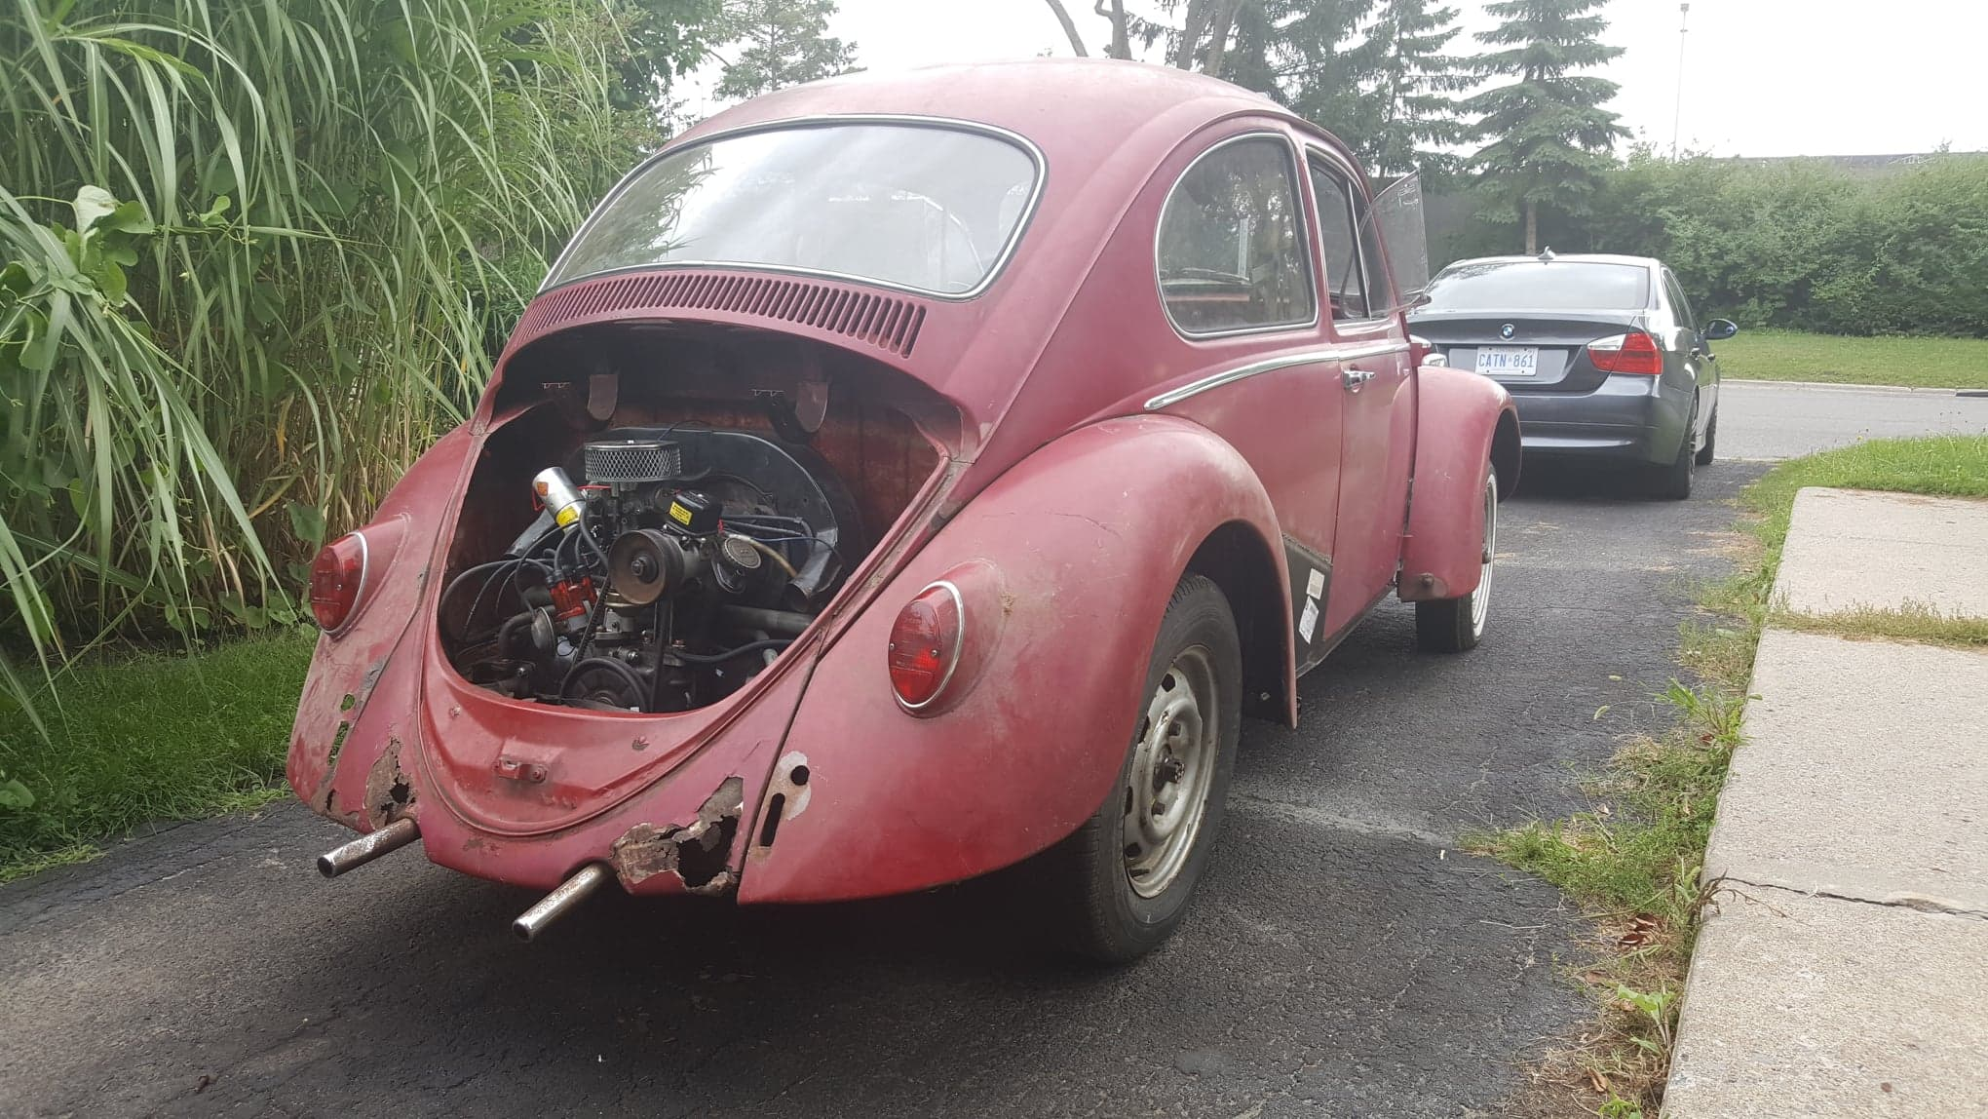
Andrei Juc
While not problem solving…

Slide 11
About Rogue Wave Software

Slide 12

“We help software eat the world faster”
Our Mission: We simplify complex software development, improve application quality and security, and shorten cycle times.
Founded in 1989
Global company, headquartered in Louisville, CO.
400 employees, 13 offices worldwide, 53 patents.
Our customers:
Automotive Software Development
Military and Aerospace
Medical Devices and Software
Embedded Software
Mobile and Communications
Game Development
Notes:
Honeywell

Slide 13








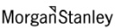













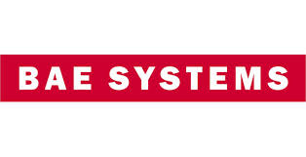





Rogue Wave Customers
We ensure the most critical and complex aspects of the entire software lifecycle to support strategic business goals while minimizing risk.

Slide 14


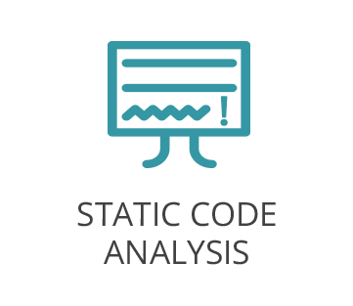

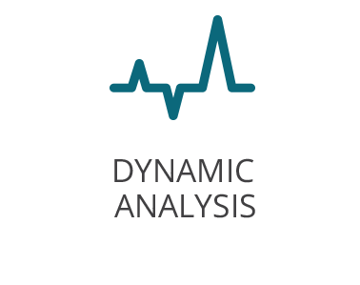
Continuous Static Code Analysis
Find defects early!
Web-based portal for reporting and analyzing results
Ability to be built into your Continuous Integration process
Very popular with mission critical industries
Allows customers to meet industry standards

Slide 15
The Problem

Slide 16






Testing at scale
Requirements
Reliable, repeatable and timely test results
Easy to reproduce/verify test results with high level of confidence
Scalable
Highly dynamic
Easy to maintain
Notes:
Honeywell

Slide 17
The Challenge

Slide 18

The early beginnings
Let’s get physical!
Test Lab filled with physical machines
Maintenance nightmare
Every machine is slightly different
Hard to replicate and pin down test failure causes
“Dirty” environment
Long execution time (18 hours per machine per run)

Slide 19

Evolution started…
Virtually first steps!
VMWare and Jenkins
Easier to maintain
Pooled resources
Template functionality helps with machine continuity

Slide 20

Stunted growth…
The terrible twos
Limited scalability with VMs
"We're giving her all she's got!"
"Dirty" machines
Test all the things!!

Slide 21
What about this Docker thing?
Docker 101
Containerization software
Uses resource isolation features of Linux in order to allow isolated OS's to run on a single machine at once.
Unlike VMs, Docker containers share the host OS kernel.
Capture, store and replicate OS state
Images and containers and Dockerfiles! Oh, my!
Notes:
Containers are completely isolated from host OS.
No hypervisor
namespaces, control groups, environments and filesystems

Slide 22
What about this Docker thing?
The good!☺
Images to share with testers and developers
Clean machine image for every test execution
Reliable, repeatable results
More scalability

Slide 23
What about this Docker thing?
The not so good ☹
Scalable to a point, limited # of hosts
CPU thermal throttling
Hardware degradation
Lost logs of test execution (don't blame Docker!)
Environment overhead

Slide 24
What about this Docker thing?
But this Docker shows a LOT of promise!
How can we reap the benefits of the system and make it scalable?
And remember, TEST ALL THE THINGS!!!

Slide 25
The Solution Future!

Slide 26
Introducing AWS
Resources as far as the eye can see…
Essentially unlimited resources
Very scalable
No more hardware woes
On-demand resources
Tools
So many tools…

Slide 27
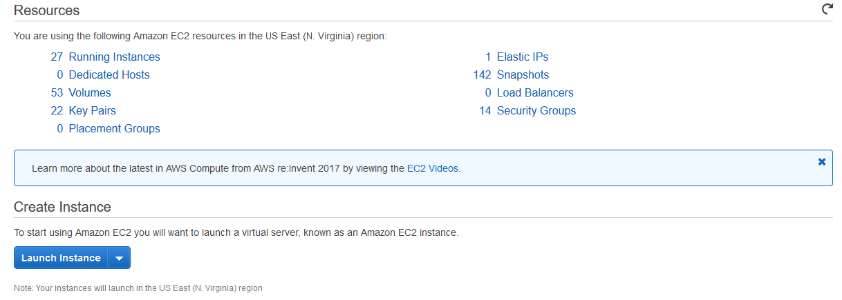
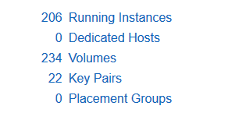
Amazon Elastic Compute
Turning dreams into reality!
Amazon Machine Images
Preconfigured services, service optimized images or a blank canvas
Elastic Container Service optimized AMIs

Slide 28
Amazon Elastic Container Registry (ECR)
Essential part of our infrastructure!
Docker container registry for storage and deployment
Used everywhere in our build and test automation
Images updated nightly with latest build
Allows developers and testers to use the same images used in building and testing

Slide 29
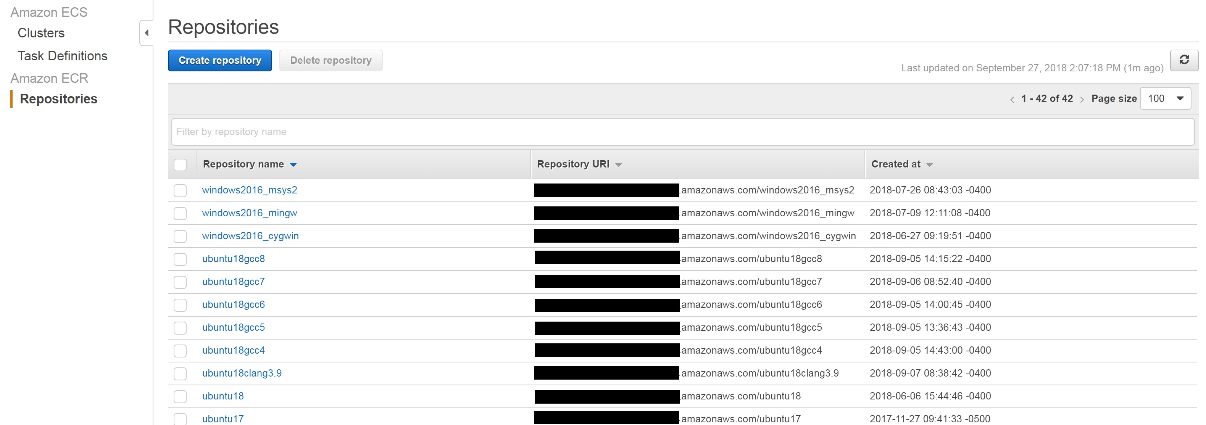
Amazon Elastic Container Registry (ECR)

Slide 30
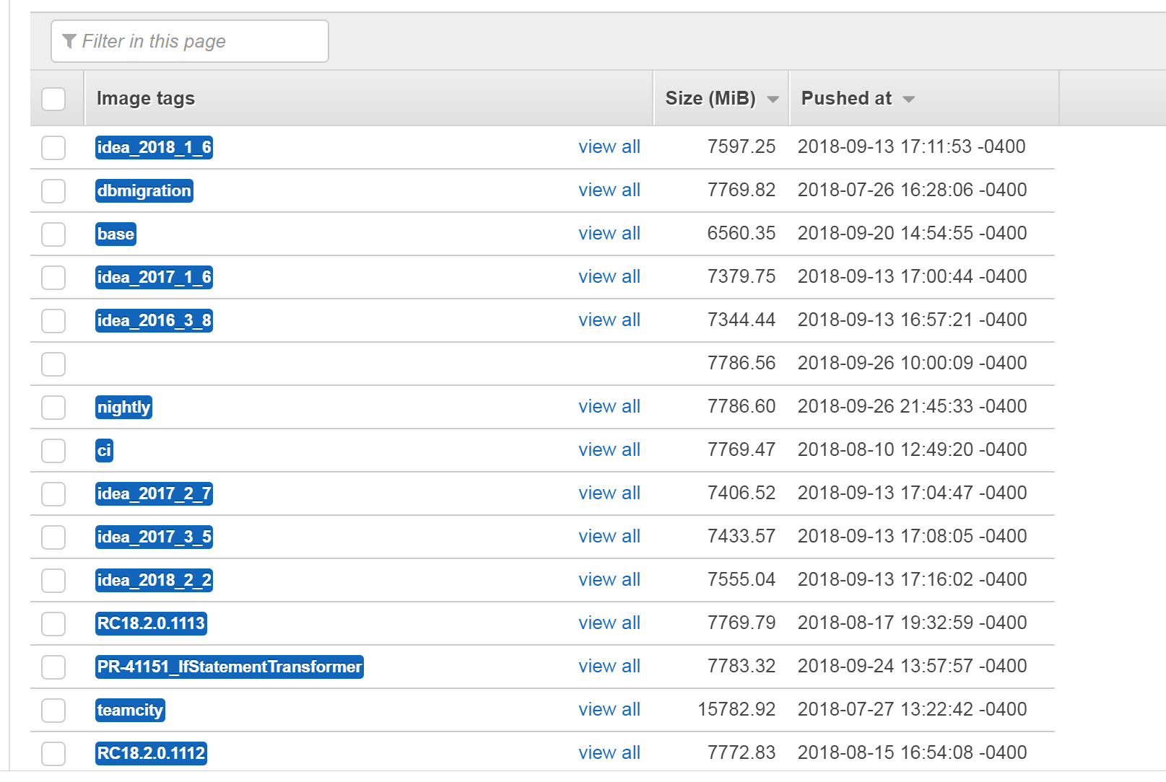
Amazon Elastic Container Registry (ECR)

Slide 31
Amazon Elastic Container Registry (ECR)
Accessing ECR images from our Jenkins test jobs
echo "Logging in to docker registry..."
export AWS_ACCESS_KEY_ID=<key>
export AWS_SECRET_ACCESS_KEY=<key>
export AWS_DEFAULT_REGION=<region>
/usr/local/bin/aws ecr get-login --no-include-email --region <region>
environment="-e SUITE_NAME=$SUITE_NAME -e RELEASE=$RELEASE -e USE_COMPILER=$CC \ –e release=$RELEASE -v /sharedbuild:/sharedbuild -p 8080:8080 \
--entrypoint /sharedbuild/utils/run_scripts.sh "
docker pull <ecr-url>.amazonaws.com/$image:$build_type #For example: ubuntu18:nightly
docker run -i $environment <ecr-url>.amazonaws.com/$image:$build_type

Slide 32
AWS Tips

Slide 33
Mind the firehose!
AWS Offers many services
Start small and work your way up.
Sometimes it's better to stay lightweight
AWS offers a lot of tools, all great under the right application, but some more cumbersome than needed
Notes:
Sometimes less is more

Slide 34
Keep a good balance of AMIs
Don't spend more time than necessary
Avoid homebrew AMIs as much as possible
Use out-of-the-box solutions for parts of the framework you don't want to maintain
Instance snapshots are an acceptable substitute for docker
Layered snapshots make it easier to manage images
Notes:
Out of the box bitnami jenkins
Out of the box ECS optimized

Slide 35
Instance type selection is important
Cheaper is not always cheaper
Use appropriate application types
Conduct experiments to find the best size for you
Process intensive applications benefit from higher core count
Notes:
T2/T3 Unlimited instances!

Slide 36
Cattle Swarms not pets
What's good for one is good for all
Use portable initialize scripts as much as possible to keep agile
Always think in terms of scale

Slide 37
Shepherd your flock
Management of your resources
What goes up must come down
Minimize idle uptime but maximize usage of AWS hourly cycle
Cover every scenario
Mistakes can be costly

Slide 38
Be prepared to maintain two systems
Some tasks are just not possible...
Some legacy hardware will remain
AWS only offers Linux and Windows AMIs
AWS SMS Service
AWS File Syncs

Slide 39
Jenkins Plugins

Slide 40
Jenkins Matrix Project Plugin
Makes our testing possible
The Configuration Matrix allows users create a multiple-axis graph of the configurations to run
In other words, "Run each of these test suites on each of these platforms with each of these modes"
Filters can be set to prevent some configs from running

Slide 41
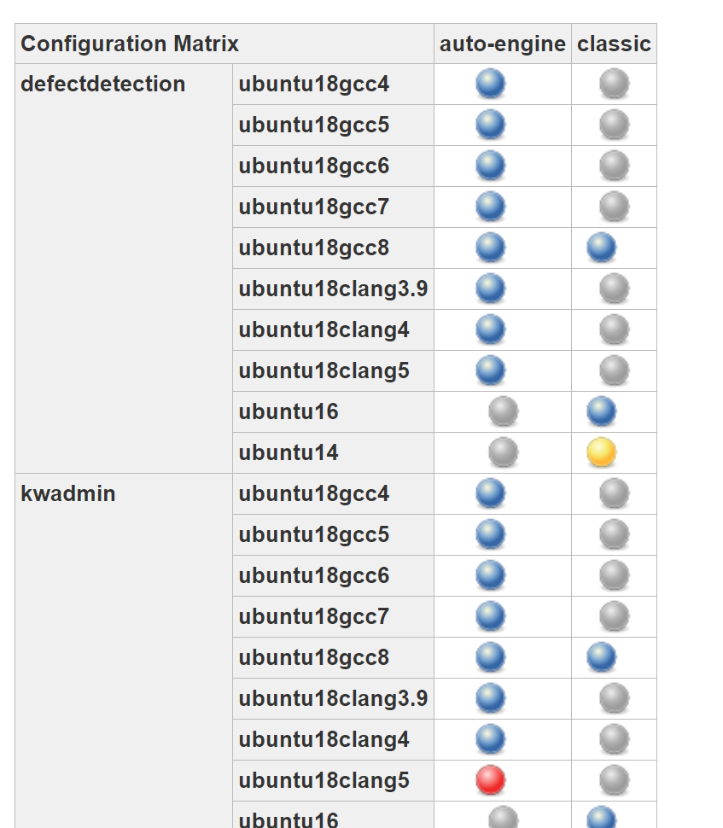
Jenkins Matrix Project Plugin
All tests passed
Some tests failed
Failure within the configuration
Not run
Notes:
Yellow balls -> Junit plugin

Slide 42
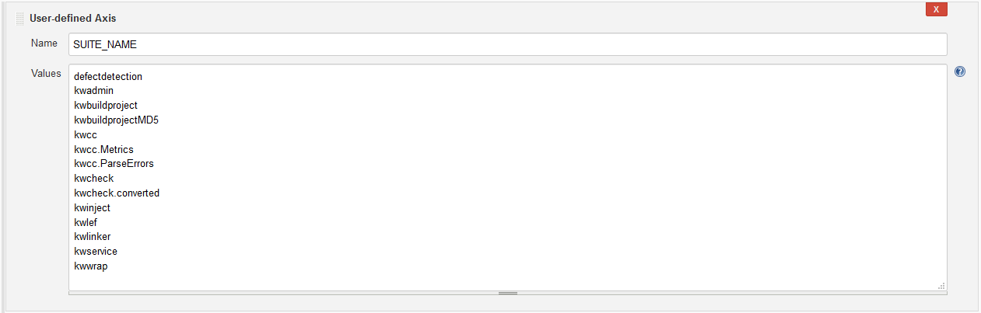
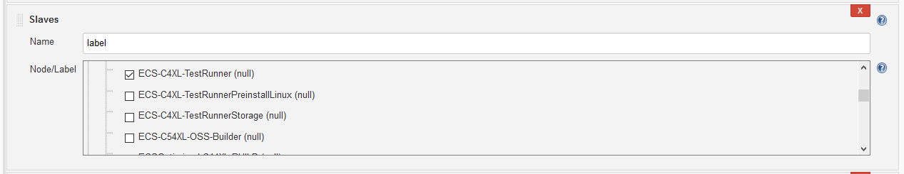
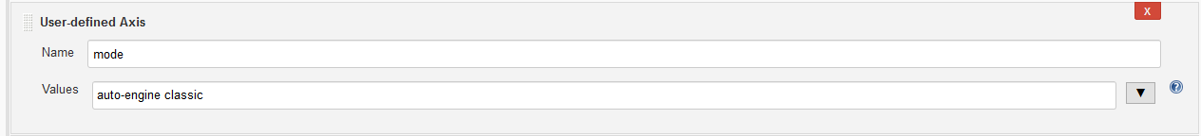
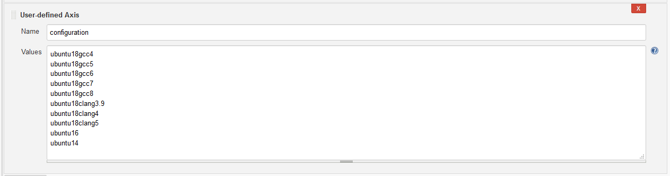
Jenkins Matrix Project Plugin

Slide 43
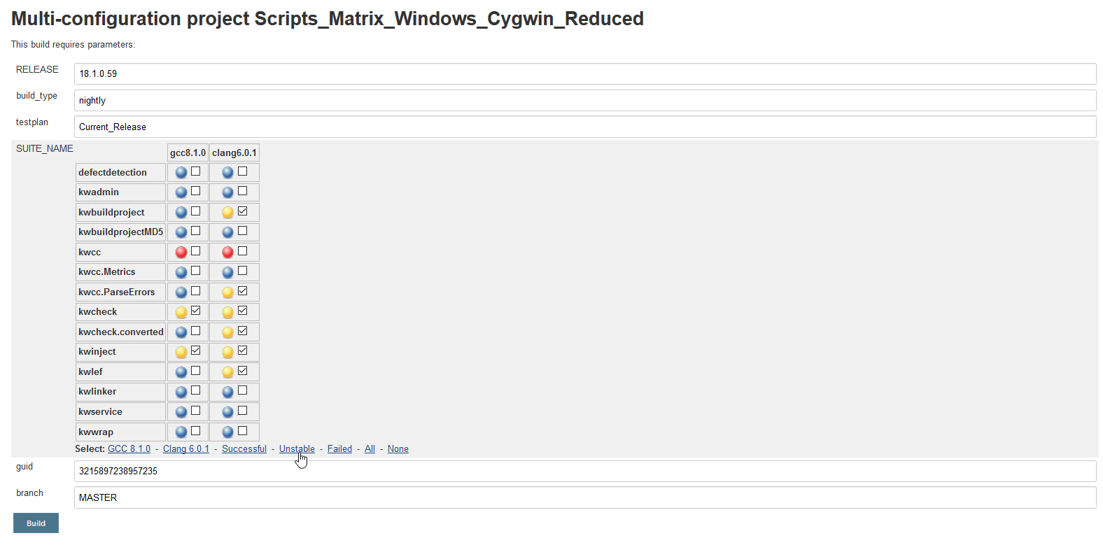
Matrix Combinations Parameter Plugin

Slide 44
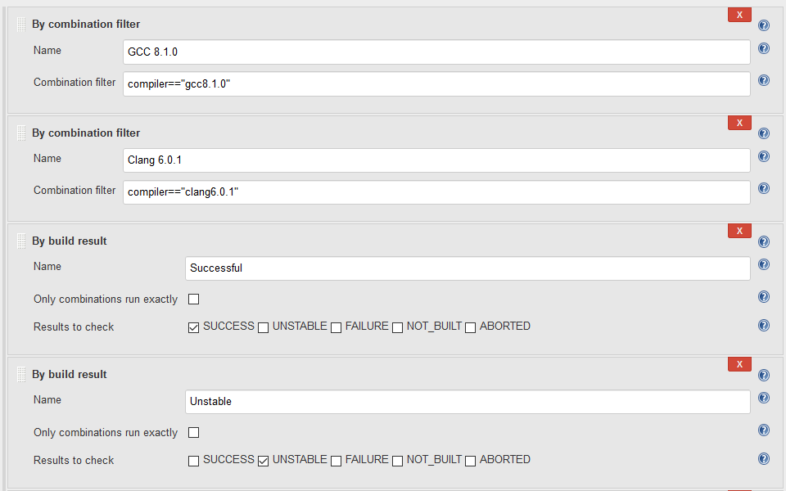
Matrix Combinations Parameter Plugin

Slide 45
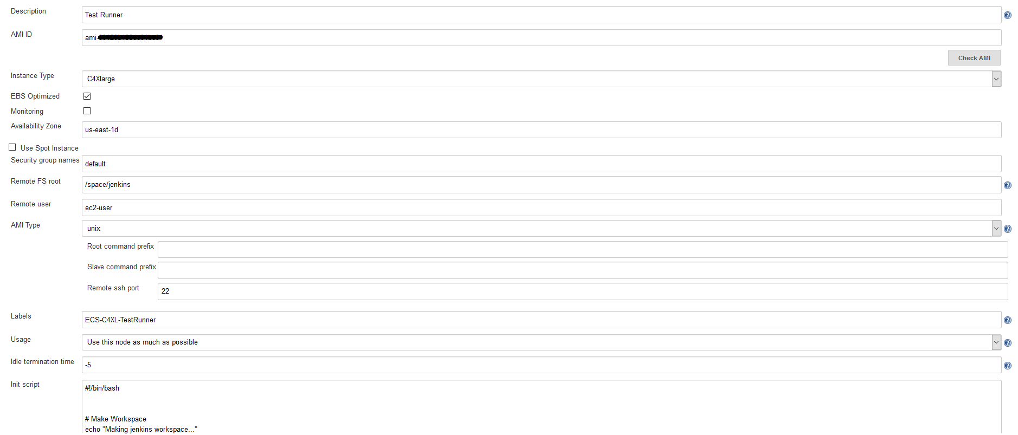
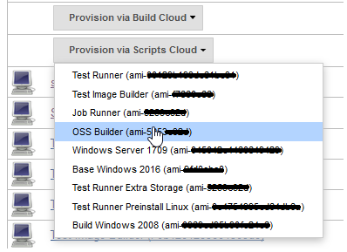
EC2 Plugin

Slide 46
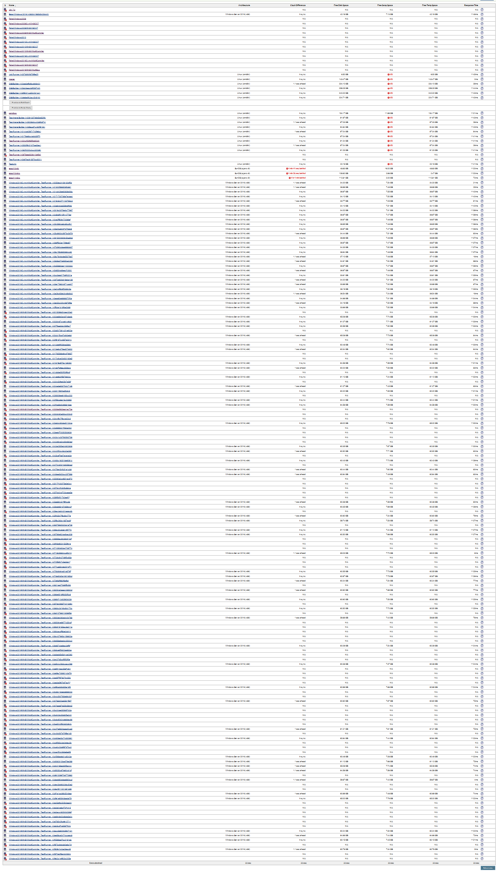
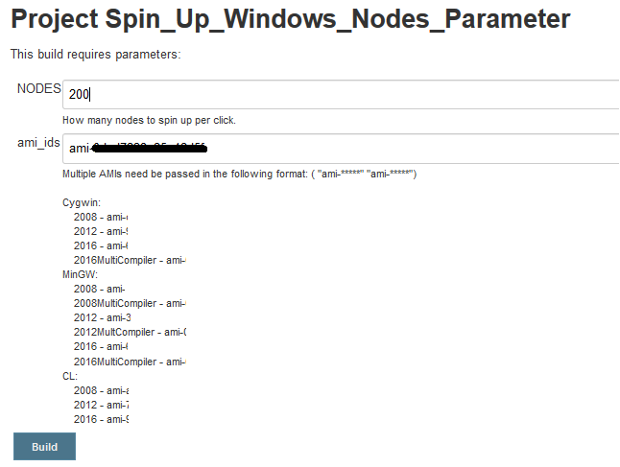
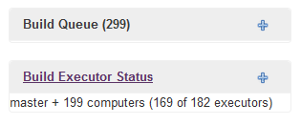
Swarm Plugin

Slide 47
What’s Next

Slide 48
AWS is much more
This is just the tip of the iceberg
AWS offers enough services to allow for full system migration
Can be used for more than just development and R&D
Marketing, customer services, support and interactions

Slide 49
More OS Support?
The selection is great, but could be better
OSX Support
AIX and Solaris

Slide 50
Closing Thoughts

Slide 51
Closing Thoughts
Always be improving
Invest in your automation infrastructure
Look for opportunities to evolve
"There's a plugin for that"
AWS does cost $$$

Slide 52
Questions?

Slide 53
Contact Us!
Scott Mills
scott.mills@roguewave.com
Twitter: @ScoringHen
LinkedIn: Look for Ottawa Scott, not the DJ in the UK.
Andrei Juc
andrei.juc@roguewave.com
Twitter: @Andrei_Juc
LinkedIn

Slide 54

We love feedback!
Give us your thoughts
Rate our session on joindin:
https://joind.in/talk/f02c7

